Slide 1
Causal and correlative time series analyses in paleontology: layeranalyzer, an R package.
Trond Reitan, PHAB, University of Oslo
Notes:
Hi! I’m going to talk about quite a lot of statistical topics here having to do with time series analyses. I recognize than this may not be familiar ground for most here. So I’m going to be as pedagogic as I can here, I hope that’s alright. In addition to talking about time series analysis, I’ll also cover one specific time series analysis tool I’ve developed, called “layeranalyzer”.

Slide 2
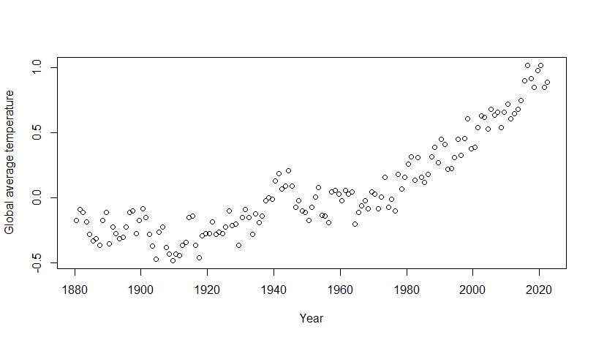
Time series
Series of measurements/estimates belonging to different time points.
Examples: global temperature, tropic δ¹⁸O, zircon records, reconstructed sealevels, fragmentation index, reconstructed sedimentation areas, extinction rates, phenotype records.
Notes:
This presentation is all about time series, so let me just briefly tell what they are. A time series is a set of data organized into time and value. That’s it!
Examples some of you may be familiar with are global temperature series (which is shown in this graph), isotope ratios, sealevel, fragmentation index, sedimentation area, salinity. From paleobiology we also got origination and extinction rates and phenotypic records. The latter can also come from more present days biological studies.

Slide 3
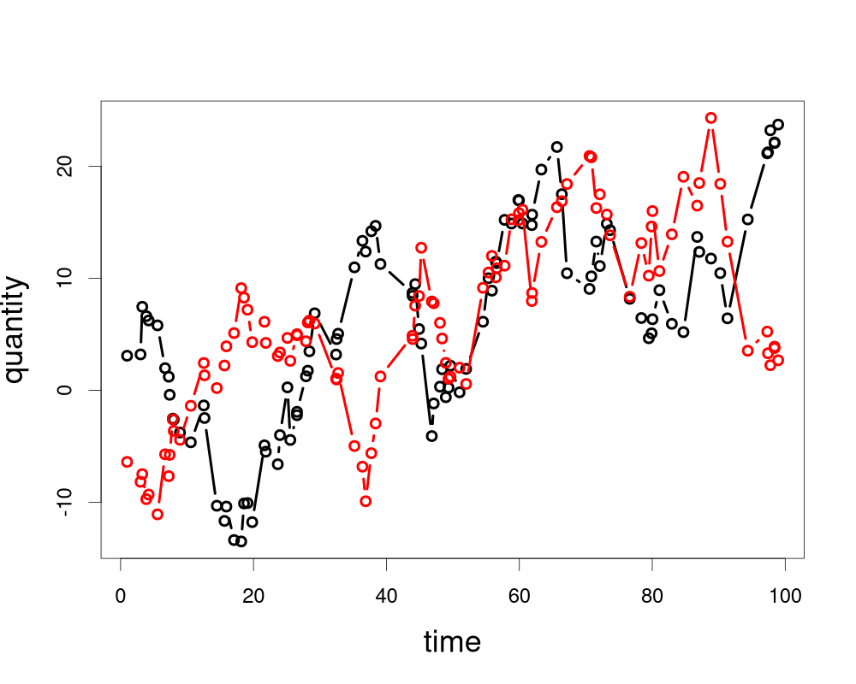
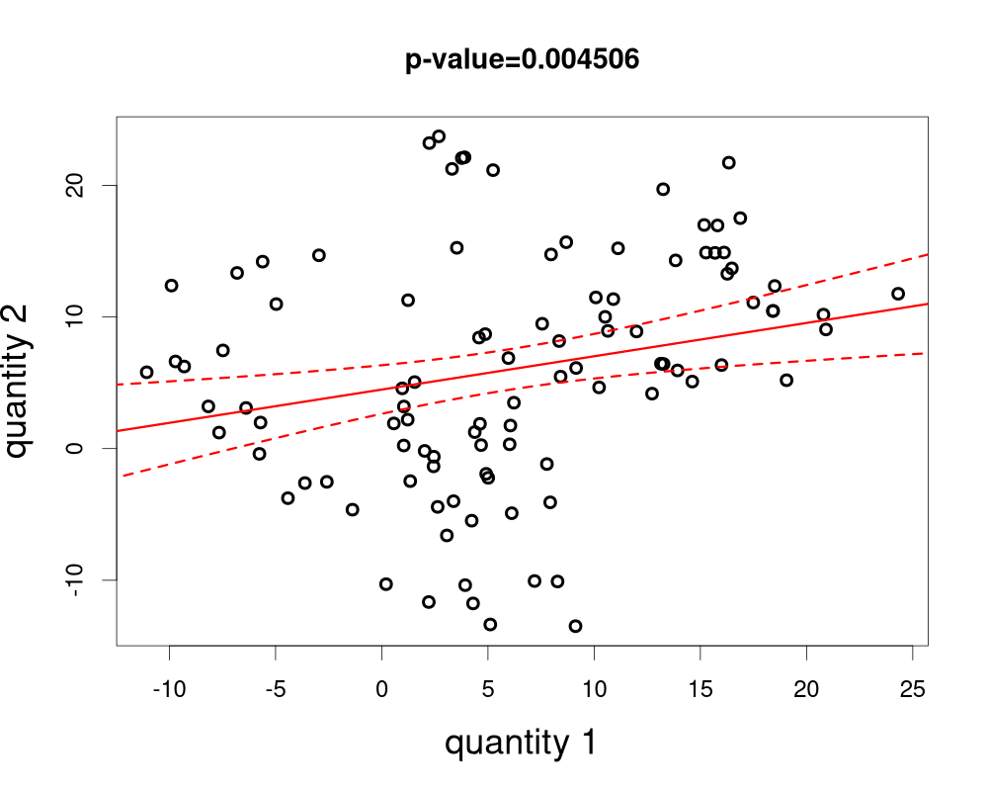
Timeseries and what not to do with them
Scenario: You think that two quantities are connected. You want to show that.
Nature: These quantities change gradually through time.
Data: Measurements/estimates of these quantities for several points in time: time series.
Extra: Some may bin or interpolate to align the two get regular time intervals. Dangerous!
Method: Use regression to test for connection.
Pro: You’re likely to get a positive result, and that will increase your chance of getting published.
Con: What you’re doing is absolutely wrong!
Notes:
So, imagine you’ve got two quantities, and your pet hypothesis says there’s a connection between them. Naturally, you want to demonstrate this theorized connection the world and get a nice publication out of it.
Now, it so happens that the nature of these quantities is that they change gradually through time. And so your data will be two time series.
A little extra note here: The time points coming from geophysics and paleontology is typically not something you have all that much control over. Each sample comes from … whenever. You may be tempted to bin these data into regular blocks in time, both in order to align measurements from the two quantities and just to make the data neater. You also might be in danger of interpolating some of the data points, since they’re empty. Let’s for now assume your quantities come naturally aligned, so you don’t run into these complicating factors, and instead discuss them later.
Now that you’ve got you data, you might want to run a regression or a correlation analysis, in order to test for a connection. (For the testing, it doesn’t much matter if you do the one or the other). Often it’s a linear regression, as in this example, but it could also be some other type. And lo and behold, you get a positive result, there is a connection! The great thing about a positive result is that you’ve now demonstrated the effect you theorized about and are so much more likely to get a publication! After all, there is such a thing as publication bias… But by now you should be suspicious. I haven’t said that your hypothesis is right, nor that you have enough data to demonstrate it!
In fact, this methodology is completely and utterly invalid! I’ll tell you why, but a demonstration is already here on this first slide. The two time series you see here were simulated completely independently from one another! And I didn’t have redo the simulation many times to get such a result, this is what you typically get. In fact, I got it on the first try! And on the second! *And* on the third! So, what is going on?

Slide 4
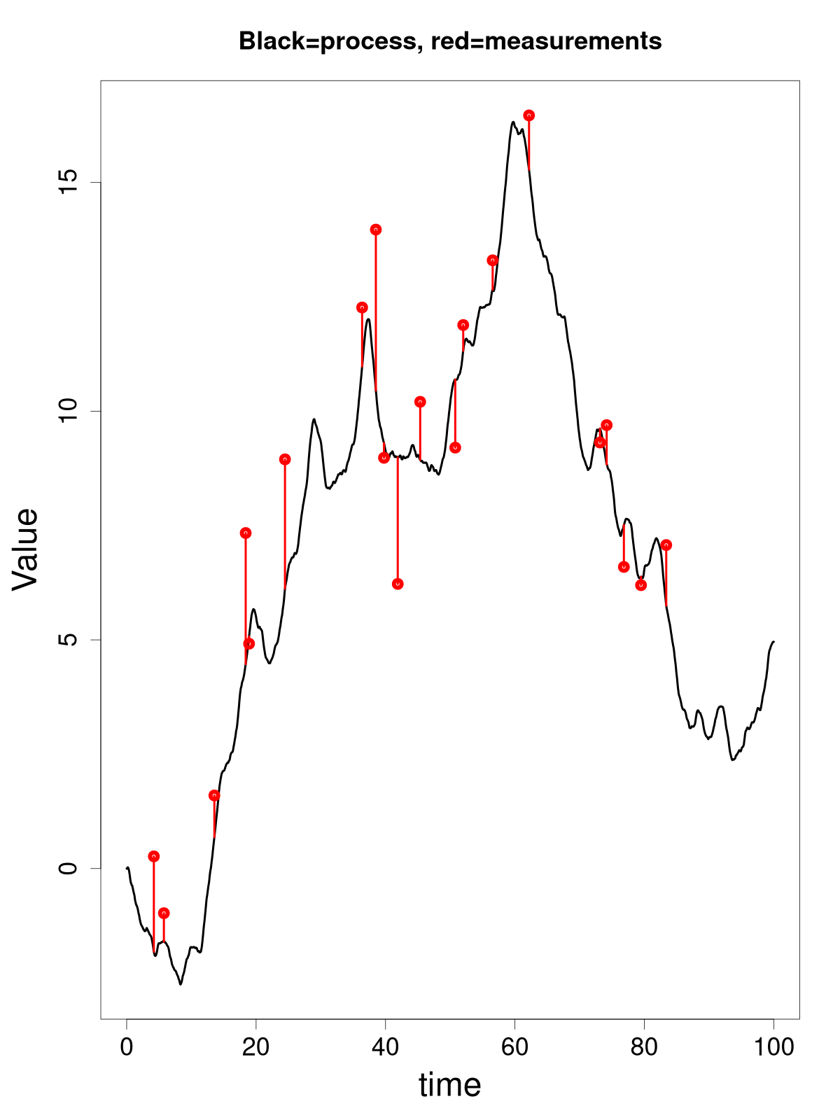
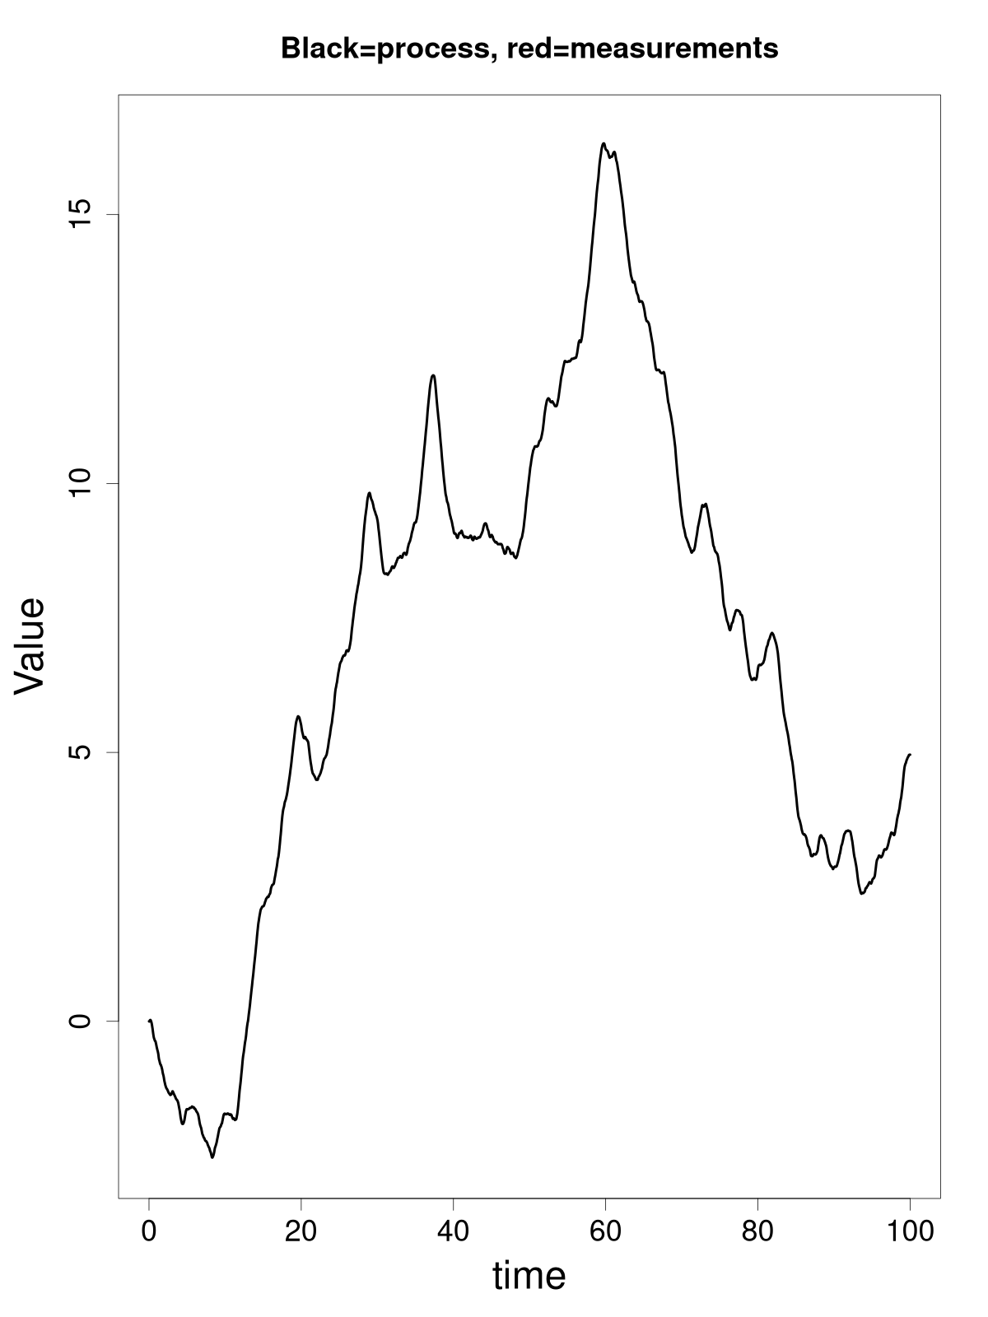
Process vs time series
Process: Stuff that changes gradually through time.
Hypotheses and theories are concerned with processes, not time series (measurements).
Difference between the time series and the process:
For each time point, the value of the time series is a noisy version of the state of the process.
The process evolves continuously in time, the time series is only representative for a few time points.
Notes:
Here’s an important concept: A process is something that quantifies what happens out there in nature, as a function of time. So, the actual global temperature, the actual isotope balance or the actual atmospheric CO2 content, for instance. Or from paleobiology, the actual mean size of a species as a function of time. And here “time” is a continuous entity.
And that’s what we make scientific hypotheses about. No one is interested in whether estimated global temperature affects estimated sealevel directly. If that’s the case, that’s a you problem that an active reviewer will pick up on if you yourself don’t take it seriously. What’s of interest is if actual global temperature affects actual sealevel.
So, let’s look at the difference between a process and a time series. First of a time series is a set of measurements (or estimates), and as such aren’t 100% accurate. There’s always some imprecision between measurement and reality, measurement noise. In some cases the measurement noise is so small it can be ignored, but that’s anyway not the biggest difference between time series and process.
The biggest difference is that there’s a whole continuum stuff happening between measurements. Well, if you time series are yearly average temperatures, one data point per year, you can’t really talk about what happens in between. But in many other applications, there could be tons of things happening between measurement points. In paleontology, you sample typically represents one moment in time, while there can be millions of years to your next sample. Now processes typically have some inertia. If the global sea level today is at 0m, it’s not going to be a 1000m tomorrow. But the more time passes, the greater the difference between the process state at one time point and the next can become. How big that change probably will be depends on the statistical nature of the process including the processes that affects it, as well as the size of the time interval.
While the measurements in our time series are assumed to be independent given the process, the process itself is has dependency from one time point in a time series to the next. And that means the measurements, unconditioned on the process state are also time-dependent. (This is called auto-correlation in statistics, by the way.) Regression assumes measurements are independent, so hopefully you can see how that becomes a problem. Let’s see how big of a problem this can be.

Slide 5
Simulation of regression on time series
A valid statistical test should reject connection at most 5% of the time when the significance level is 5%. Is that true for regression on time series?
Checked the linear regression test, linear regression on the changes and a time series model using simulation.
Pairs of time series created by sampling the state of two independent random walk processes (at non-regular time steps).
Result:
77% positives for regression.
16% positives for difference regression.
5% positives for process test.
Notes:
To see how bad a regression analysis on time series data can go, I did a small simulation. I simulated 1000 times, sampling two processes completely independently from each other. So in each simulation there’s no connection between the processes. For instance, the two processes could be Mars global temperature and North Atlantic cod stock.
I didn’t put any measurement noise on the time series. It would be more realistic if there was. But I also wanted to do a test where I actually took the process nature into account, a correct test, and that could run much faster if I didn’t have to take measurement noise into account.
I then performed linear regression analysis on the time series and extracted a p-value from said analysis. I used a significance level of 5%, so the chance of a false positive ought to be just 5%. I could aim for a lower percentage, but that would make it more difficult to actually find a connection that is there.
I also performed a linear regression analsyis on the changes between one measurement and the next. Now for the process model I used (which I will talk more about in the next slide) if the time steps were regular, these changes would be independent and always with the same variation. The time steps are however sampled randomly, which at least breaks the same variation assumption.
Lastly, I performed a process analysis using the correct process structure and performed a likelihood ratio test looking for a connection. So that would be the correct way of analysing this.
The linear regression analyses had a 77% chance of getting a positive result. Now that’s great isn’t it? Far more chance of getting a publication with a positive result. You can conclude that cod stock and Mars temperature (for instance) is connected! Send it to Nature, they’re not interested in methodology. Maybe finish the paper stating that Mars can be terraform if we just harvest more cod?! Obviously, you shouldn’t do this! There is no connection, so what you got was a false positive. With a 77% false positive rate, you might as well declare that there is a connection before even looking! By the way, this problem only gets worse, the more data you have!
I also got 16% false positives regressing on changes. That’s better, but it’s still not good. Even a fairly small break in assumptions can make a noticeable difference. I also performed a simulation study using a different process, and in that case, I could get up to 99% false positive both on the original data and on changes!
Maybe you could calibrate linear regression so that you did get a 5% false positive rate. But then you need to simulate the data according to its statistical properties, and that means finding the process description. So you may as well just to likelihood ratio test for the process model. So … using the process test I finally got the false positive rate down to what it should be, 5%.

Slide 6
Time series troubles
Binning:
Removes information -> more difficult to detect connections
Valid to do time series analysis on, though.
Avoid if possible, but sometimes you have to.
Interpolation & smoothing:
Creates autocorrelation that has nothing to do with the process
Fiction in -> fiction out
Maybe taking such post-processing into the process model can alleviate problems, but that has yet to be shown.
Notes:
I mentioned earlier that binning and extrapolation before analyzing the time series is problematic. Let’s quickly run through why.
Binning is when divide your time line into bins and for each time bin you aggregate the set of data points in that bin. So you’re removing information, and are thus decreasing your chance of finding anything.
What can be said for this practice, is that performing time series analysis on binned data is valid, though. Provided you are performing a valid time series analysis, of course. You are not increasing the chance of type I errors, i.e. you aren’t getting more false positives. But you are getting more false negatives than you could have.
An lastly, sometimes you cannot avoid binning. For instance, with extinction and origination rates, you have to look for extinctions and origination over a certain time interval in order to estimate these rates. Typically these intervals are defined by geological formations though, so the resulting time intervals aren’t regular.
Some time series analysis techniques, such as ARIMA, assumes the time intervals are regular, but not all techniques are so limited, as we’ll see later.
Interpolation and smoothing is a much worse thing to do to a time series, though. You get dependency between the “measurements” that have nothing to do with the physical process. This mean that when you analyse each time series in order to find how the process behaves on its own, some elements you find will belong to the process and some will belong to the stuff you yourself did to the poor time series!
Basically, the principle is that if you mix measurements and fiction, what you get out as a result is going to be fiction. Science fiction, in a sense! The analyses you do aren’t going to be valid!
In the tool I’ll present, the extra elements introduced by smoothing and interpolation may be possible to separate from the natural process. So maybe(?) it is possible to get a valid analysis in some circumstances. But that has yet to be shown. We’d have to do a simulation study to examine this.

Slide 7
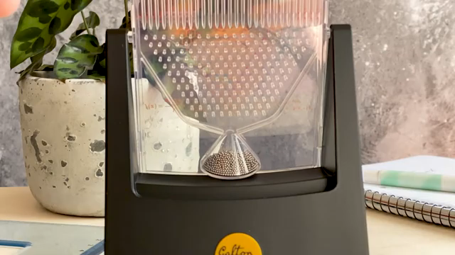
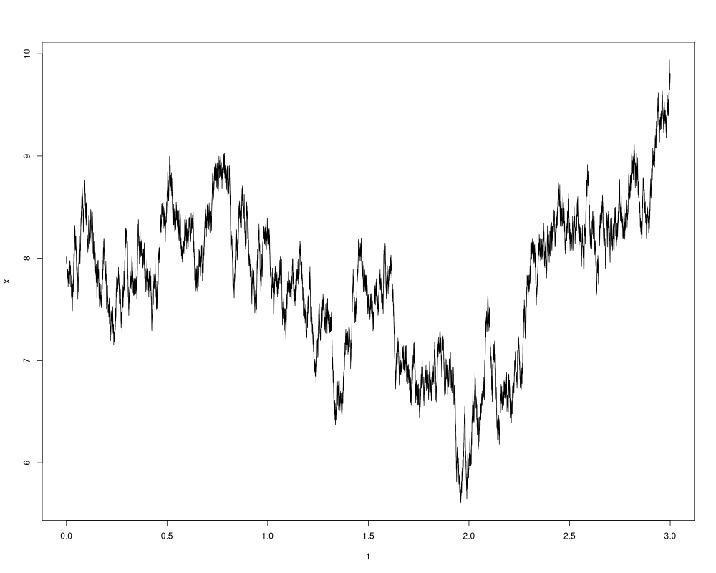
The simplest process model: the random walk
RW: Step left or right randomly – repeat.
Make the step sizes smaller and the number of steps bigger -> Wiener process.
W_{t} is function of time.
It is continuous.
It is the basis for stochastic differential equations.
Notes:
The clip here shows a contraption that bounces many small steel balls down a set of pins. Because of the chaotic nature of such bouncing, it’s pretty random which route each ball takes downwards, 50/50 for going left or right for each pin row. The route of each ball can be called a random walk. What you end up with in the end is a normal distribution centered around where things started and with a variation that depends on the square root of the number of pin rows.
If you make a mental picture of this process while making the pins and balls smaller and smaller while increase the number of pin rows into infinity, so that you can assume the steps taken are continuous, you get the Wiener process. It’s the mathematical idealization of a random walk, where you can scale up or down as much as you please. I’ll normally simply call this a random walk though, but keep in mind that what I really mean is this mathematical idealization, the Wiener process.
The Wiener process, W_t, is a function of time. It’s a stochastic function of time though, you can’t predict where it goes.
It has some good properties, there no discontinuities in it. No sudden change from one nanosecond to the next. So it has some “inertia” if you will.
And it’s a basic building block for stochastic differential equations, which is what the tool I’ve developed with others uses.

Slide 8
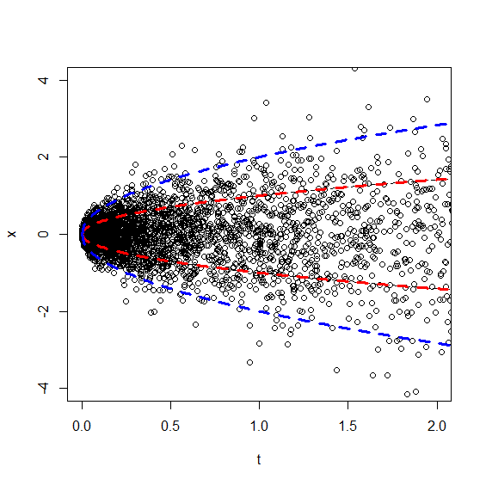
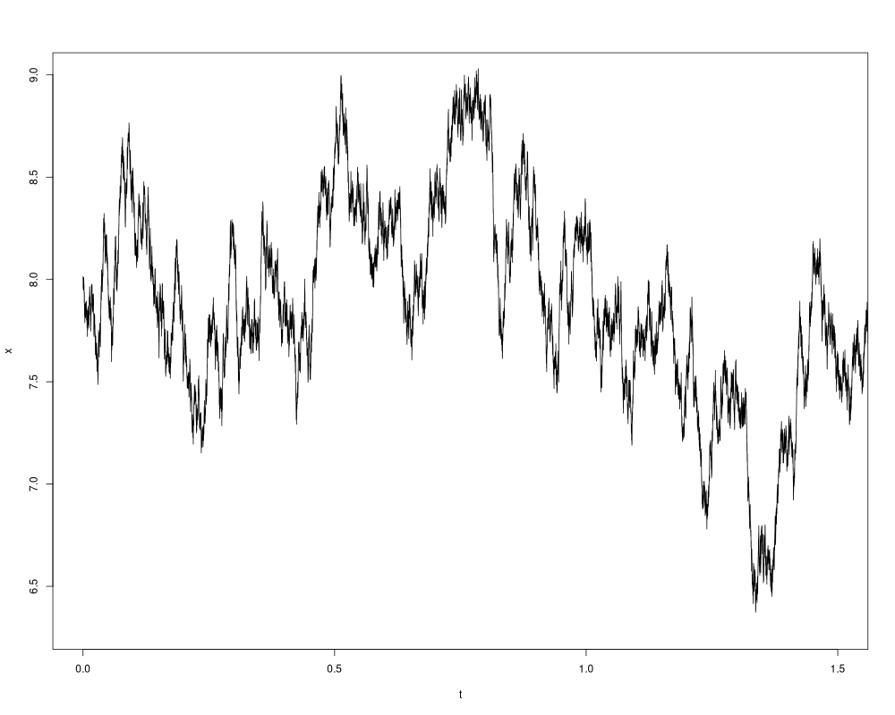
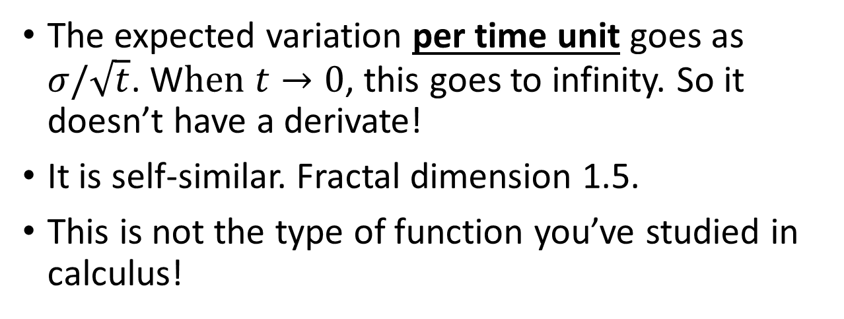
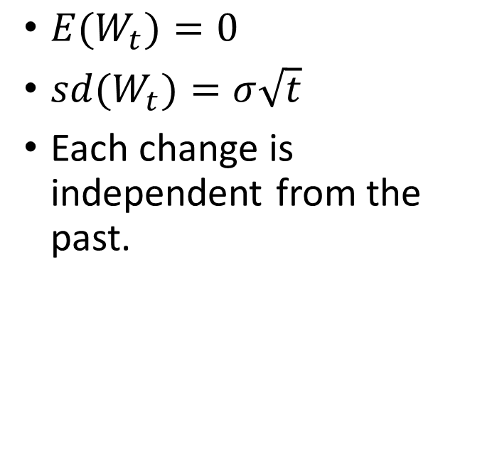
Properties of the random walk
${E(W}_{t})=0$
${sd(W}_{t})=σ\sqrt{t}$
Each change is independent from the past.
Change
Time interval
The expected variation per time unit goes as $σ/\sqrt{t}$. W$hen t→0$, this goes to infinity. So it doesn’t have a derivate!
It is self-similar. Fractal dimension 1.5.
This is not the type of function you’ve studied in calculus!
Notes:
Since the Wiener process is so important, I’ll walk you through some properties: If you start a lot of random walk, and let a certain time interval go by, the average change is zero. Or stated statistically, the expected value of the change is zero. The variation, as summarized by the standard deviation, increase with the square root of the size of the timer interval, though. Which is what you see to the graph on the left. Lastly each change is independent from the past changes. It only depends on where the process last ended up. (For the statistics geeks, this property is known as a Markov chain).
These properties really says all you need to know about the random walk. They don’t sound too intimidating, do they? However, you get some weird side effects from this. First off, the expected variation per time unit goes to infinity when you reduce the time interval. That means the random walk doesn’t have a derivative at any point in time! How many functions do you know of like that?
Secondly, it is self-similar. Zoom in on a part of the random walk while scaling the right way, and you get a random walk with the same properties as before. It’s a fractal, with dimension 1.5 (so it’s somewhere between a line and an area)!
Now, I’m not trying to lure you into mathematical mysticism here. I’m just saying that a random walk is something outside of math you are usually exposed to. It can be a little difficult to wrap your head around and get an intuition on, so don’t take it too lightly.

Slide 9
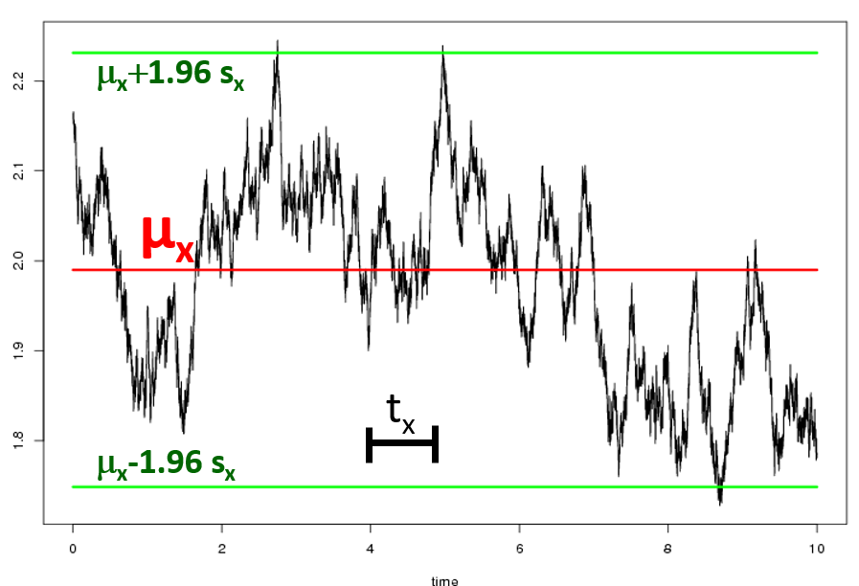
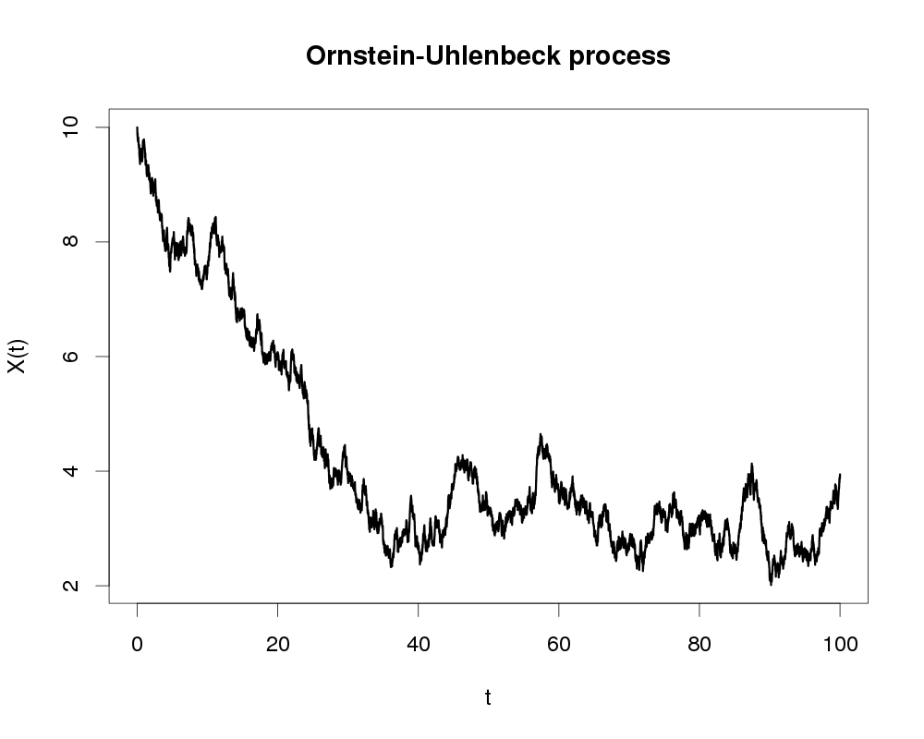
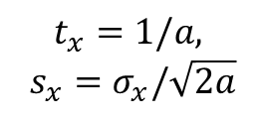
One process linear SDE, the OU process
$$dx\left(t\right)=−a\left(x\left(t\right)−μ_{x}\right)dt+σ_{x}dW_{t}$$
Deterministic part
Stochastic part
Starting outside the equilibrium
x(t)
$$t_{x}=1/a,$$
$$s_{x}=σ_{x}/\sqrt{2a}$$
time
time
Notes:
Now let me finally introduce you to what layeranalyzer and similar tool (such as paleots and evots) are based off, linear stochastic differential equations. Here represented by the grandfather of them all, the Ornstein-Uhlenbeck process. It’s what you get when you make a single process linear SDE. It also happens to be what you get for phenotypic evolution when you look at the combination of natural selection and genetic drift for a stable optimum and the simplest possible fitness landscape. So research questions in biology and paleobiology are tied up to this particular process.
It describes how the process changes on an infinitesimal scale. The change is a deterministic drive towards a mean value, mu-x, proportional to the displacement (the process state x-of-t minus mu-x), with “speed”, a. It’s not quite right calling ‘a’ a speed through. The speed at any time is ‘a’ times the displacement. If this was all, this would be a differential equation where the function would just go exponentially towards mu-x and then gets stuck there.
But there’s also a stochastic part, which is simply a scaled version of a change coming from the Wiener process. It’s there to describe all the stuff you don’t have any control over in the process. Whenever you’re thinking about a process and drivers of that process, you may then despair and think: “No, it’s not as simple as that! There’s all this stuff that affects the process that we don’t measure”. Well, this is the term that represents that! Except it’s not as simple as that! There can be signals in the noise that we can find a description for, as we’ll later see.
Without the deterministic part, the equation would simply describe the random walk. With both the deterministic and stochastic part, you strike a balance, and you eventually get to an equilibrium situation with a stable stationary distribution.
The process can be described by the three parameters in the equation. But some more intuitive properties can be derived. Mu-x is fairly intuitive to begin with, it’s the long-term average of the process. The stochastic parameter is a bit harder. However, the long term variation scales proportional to it, though it also depends on this more mysterious “speed” parameter, ‘a’. You can get a characteristic time though, by inverting it. This characteristic time describes how much time has to go by for the correlation between the process state at one time point and the nest drops below a certain level. For time intervals much larger than ‘t-x’, the changes will be uncorrelated and the process will look like white noise. For time intervals much smaller than ‘t-x’, it’ll look like a random walk. But for time intervals in between, you need the whole description.
If you start the process far outside the equilibrium so several standard deviations away from ‘mu-x’, it’ll be driven towards the equilibrium. The displacement will on average be reduced by one on the log scale, each characteristic time. Soon it’ll be within what you can expect from the stationary distribution, and starts wiggling about like nothing had happened.
There’s ways of expanding this process, by adding specific trends in mu-x or even sigma-x (the evots package allows the latter, something layeranalyzer so far doesn’t). And this can again be tied to specific research questions. Questions like is the optimum slowly changing linearly in time. Then again, maybe we’re looking at time frames shorter than the characteristic time, in case the deterministic part is negligible and we’re left with a random walk. So there’s stuff to examine in this framework even if we’re not contemplating more than one process.

Slide 10
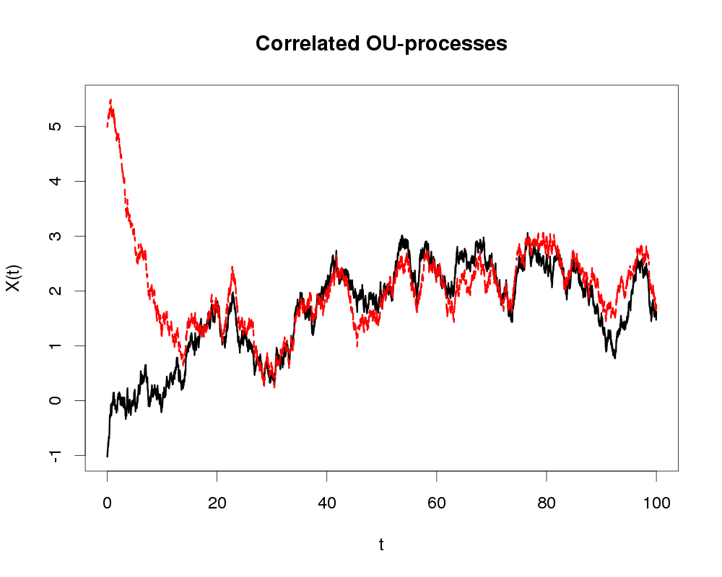
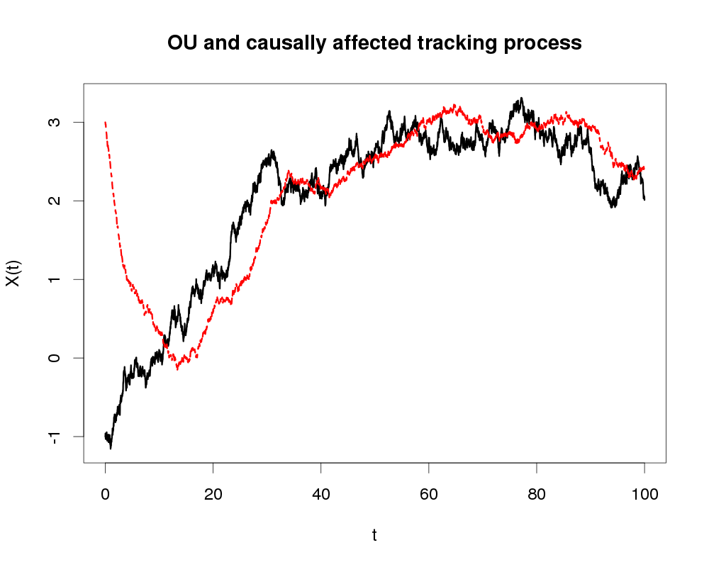
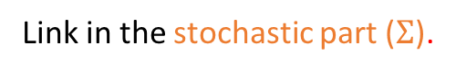
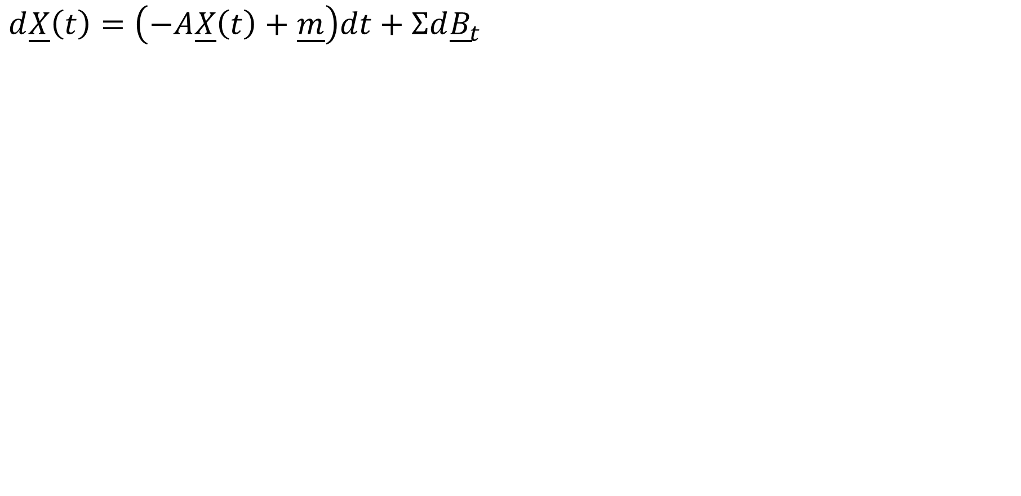
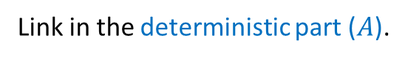
Multiple processes, causal vs correlative
$$d\underline{X}\left(t\right)=\left(−A\underline{X}\left(t\right)+\underline{m}\right)dt+Σd{\underline{B}}_{t}$$
Exemplified by two processes (so X(t) is 2-dim.)
Deterministic part
Stochastic part
Black line=OU
Red line=OU-like tracking of
black line
Link in the stochastic part ($Σ$).
Link in the deterministic part ($A$).
time
time
Models:
x₁
x₂
x₁
x₂
x₁
x₂
x₁
x₂
x₁
x₂
Model 1
Model 2
Model 3
Model 4
Model 5
Notes:
Having only one time series is a little bleak. Sure, there can be research questions connected to the statistical nature of the process underlying a single time series. But things really get interesting when there’s two or more time series, because then we can start looking for connections between the underlying processes. A linear SDE with multiple processes take the same form as the OU process, except that the process state itself, the expected value and the random contributions are now vectors, while the term in front of the process state and the stochastic contributions are now matrices.
For illustration, let’s have just 2 time series, each associated with one process. If there’s no connection, that’ll simply be two separate OU processes, not interesting enough to show that here now.
However, if you put an off-diagonal term in the Sigma matrix associated with the stochastic part, the two processes start to wiggle up and down in approximate synchronicity. This is what we call a correlative connection. If you believe that all real correlations need a causal explanation, finding a correlative link would signify a common cause, a driver for both processes. Well actually a driver you can’t find any pattern in.
If you put an off-diagonal term in the “A” matrix, which is in the deterministic part, you get a causal connection instead. I’ll talk more about causality in the next slide, but what I’ll say now is that unlike correlation, causal connections have a direction. If you look at the rightmost slide, the effect, X2, is lagging behind the cause, X1. Just with two processes, you can already have 3 different causal models, X1 affecting X2, X2 affecting X1 and X1 and X2 both affecting each other.

Slide 11



Causality and linear SDEs
At least 3 concepts of causality.
In all cases, the cause (X) should come before the effect (Y) and there should be a statistical dependency between them. But in addition:
Granger causality – X causes Y if you can better predict Y knowing the past of both X and Y than knowing just the past of Y. Linear SDEs allows this.
Interventional causality – X causes Y if changing the course of X (as opposed to not doing so) will in probability change the course of Y. Linear SDEs allows this.
Counterfactual causality – A specific outcome of Y can be changed to another specific outcome, by changing X. Linear SDEs do not allow this.
Notes:
Before moving on, I’ll have to discuss causality, cause and effect, because these words means different things to different people. There are some commonalities. So there should be a statistical dependency between cause and effect. Also, the effect should come after (or at the same time and place as) the cause.
Granger causality understands causality in the form of information transfer. If you want to predict what happens after a given point in time to process Y and you are in a better spot to do that if you know the past not just of Y but also X, then X causes Y. It doesn’t mean that you will know exactly what happens with Y after that point in time, but the expected outcome should be changed when adding the information from X and the uncertainty concerning Y should be less. This is considered the weakest causality concept, and by some it is seen as a form of correlation, not causality. Experimental control is the gold standard for establishing causality. But you can’t do experiments on Earth’s past evolutionary history or geological processes, and then information transfer is the only thing we can test. Linear SDE has provably this type of causality baked into it.
Interventional causality goes one step further and allows for experiments, including thought experiments. It says the information transfer you get in definition 1 should also happen if you are able to interfere with the cause and put it under experimental control. In other words, you should be able to alter the future of Y to some extent by controlling X. This also allows for thought experiments, by asking “what would have happened if we altered X at this point in time”. So, for instance, what would happen with the non-avian dinosaurs had the comet not fallen 65Myr ago? But this is answered in probability. Even if you have a causal model for large-scale evolution, you wouldn’t necessarily know exactly how many non-avian dinosaur species there would be 64 Myr ago or now. Still, this is a stronger concept than Granger causality. While this is not something you can know is true for linear SDEs, since this concept also is concerned with physical interference. But linear SDEs do allow for this type of causality.
The last concept is that of counter-factual specificity. This is the strongest definition of causality I know of. Here, you should be able to say specifically what would happen with Y if X had been changed. So if the comet hadn’t struck 65Myr ago, which non-avian dinosaur would be lecturing at this spot right now, and what would the topic be? Basically, I think this concept is too, strong. If you want this, maybe you also want to be able to fly and punch the laws of nature in the face, like Superman? Pretty much every interpretation of quantum mechanics disallows counterfactual specificity. I think the many-world interpretation allows it, but only on the multiverse level, so you’re anyway in Superman territory. Calm down and scale back the ambition to level 1 or 2 is my advice.

Slide 12
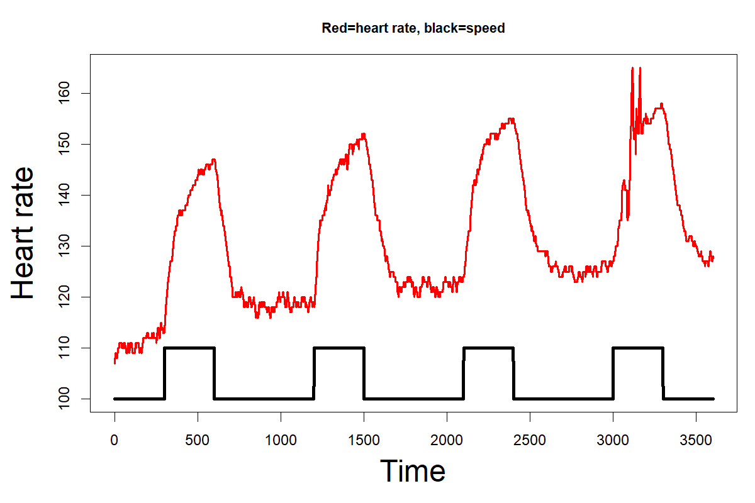
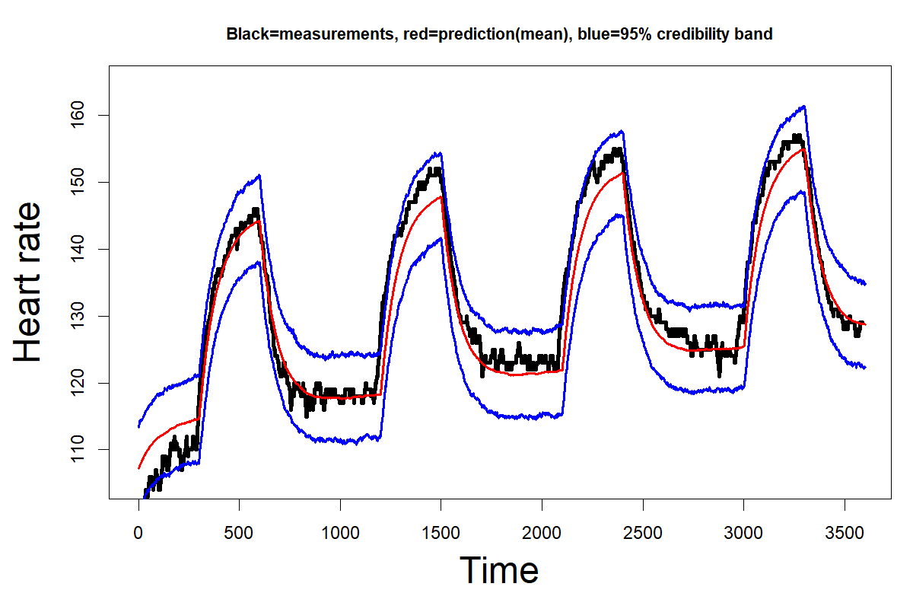
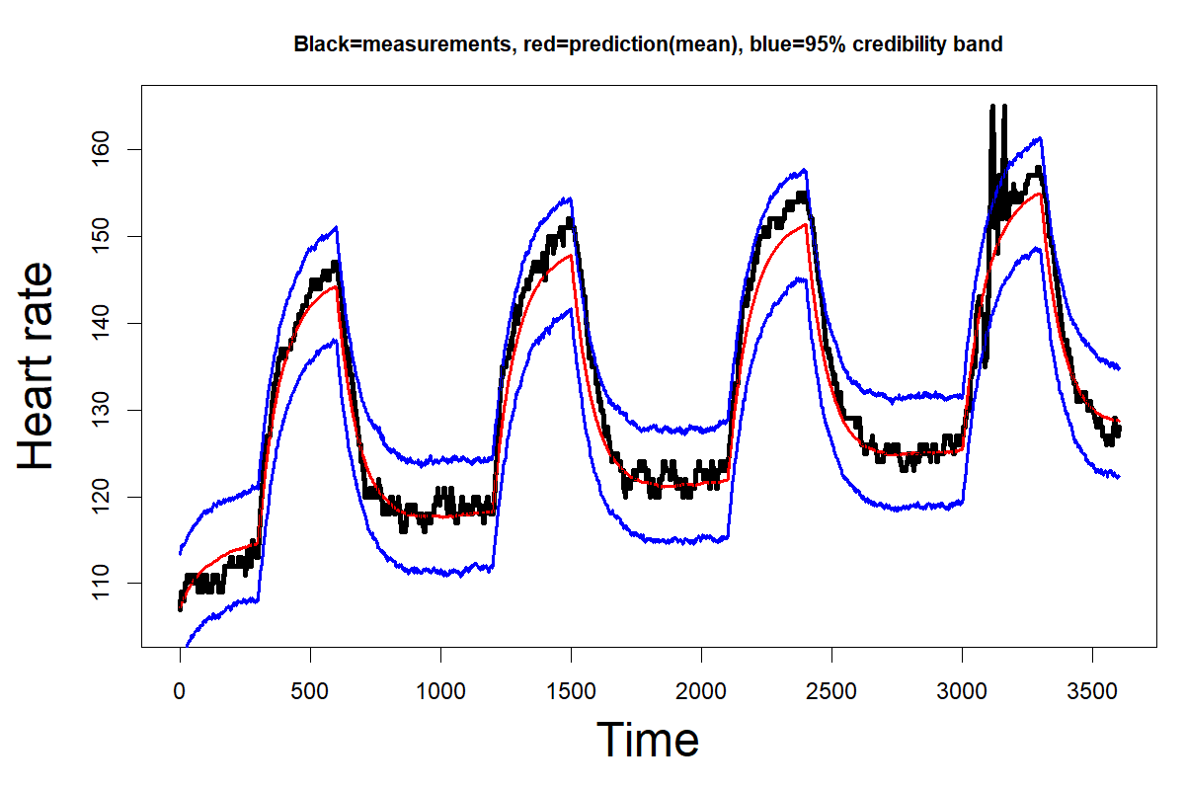
Causality – a real-world example
Threadmill experiment: Measuring heartrate while changing the speed.
compare.layered(m0,m1,m2,m3)
# log(lik) Post. Prob.(%)
#Null model 1669.033 0
#Correlation 1665.201 0
#Causal,H->S 1668.881 0
#Causal,S->H 1746.328 100
Result: Speed causes gradual change in heartrate.
Notes:
Here’s a real-world example of a causal link. It’s a bit frivolous and outside of PHAB’s interests. But it was data that I could easily collect myself and it is an example of experimental control, so an example of casuality type 2, interventional causality. This spring I was trying to get in shape and so I was trying the threadmill. Now I’m not good at running, so I did brisk walking and easy jogging interchangeably. So I had experimental control over the speed, while measuring the heart rate. I first did a connection analysis to see which connection model worked best, and luckily speed affecting heart rate came out on top, very decidedly!
This also shows you an example of the code used for showing the results. In this case I did Bayesian inference, so the probabilities at the end are simply the probabilities for each model. 100% support for the model that makes most sense, in this case.
We can also take a look at what this particular model predicts, given only the speed. This aligns very well with the actual data! When the speed increases, the predicted heart rate gradually increases to approach a new level, rather than just jump straight up, like a correlative model would predict. And likewise, when the speed is reduced, the heart rate gradually changes back again. (Actually, since speed is under experimental approach and correlative links don’t allow for interventionalist causality, I shouldn’t be able to predict heart rate using speed for a correlative model at all!)
Now, the model parameters have been adapted to the data, so maybe this isn’t so impressive. But I also had another go at the threadmill, with the same speed changes, but the heartrate data and the predictions are in this case altogether independent. Still, the model predictions fit fairly well even now. The initial heart rate was different here, and it might be that the shape I was in wasn’t exactly the same as the last time, but still the data is well withing the uncertainty bounds!

Slide 13
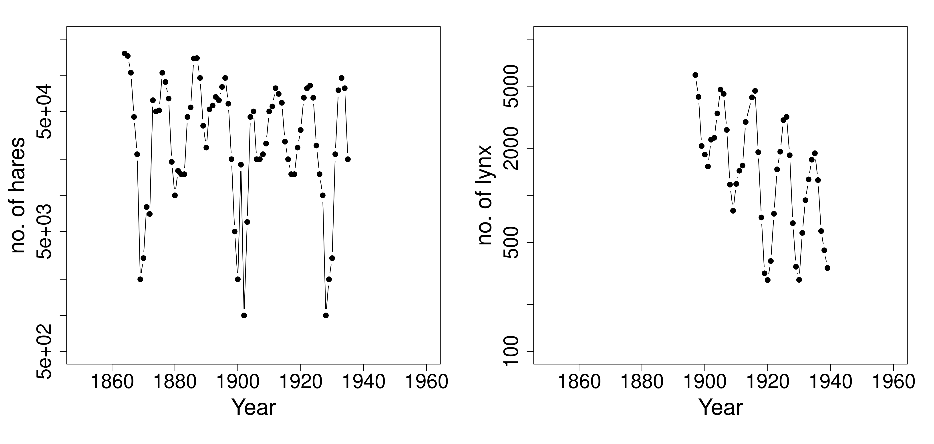
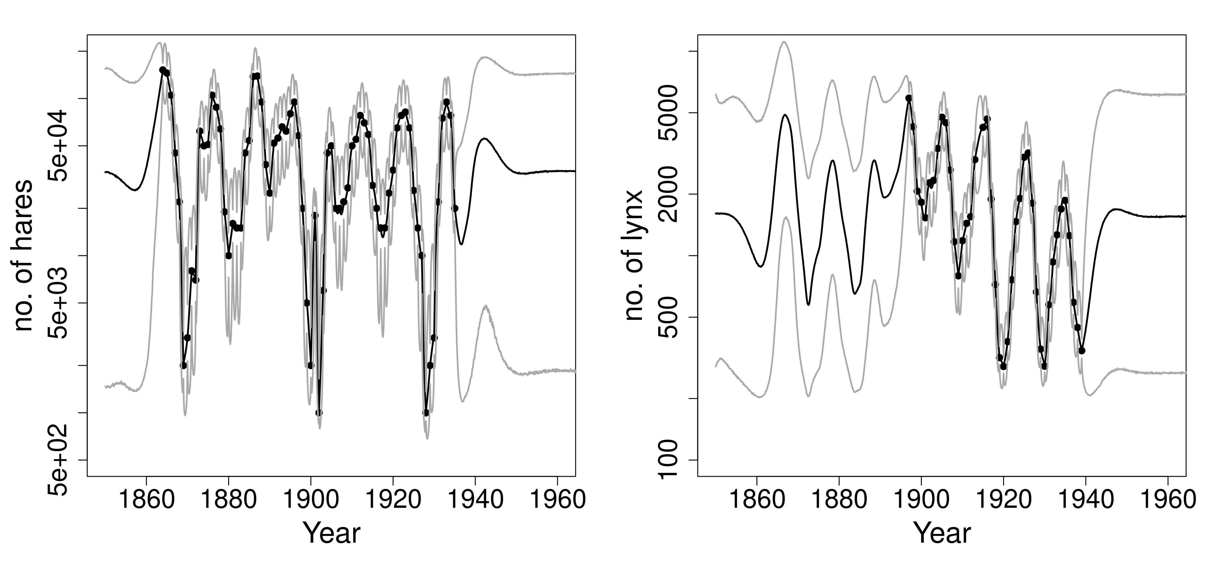
Example, two possibly connected ecological series
Hare and lynx capture data spanning over 100 year. Assumed indicative of abundance.
Connection analysis: 2-way causal feedback loop. Positive from hares to lynx, negative from lynx to hares.
Elton, C. S., and M. Nicholson. 1942. The ten-year cycle in numbers of lynx in Canada. J. Anim. Ecol. 11:215-244.
Maclulich, D. A. 1937. Fluctuations in the Numbers of the Varying Hare (Lepus Americanus). University of Toronto Studies, Biological series 43.
hare.struct=layer.series.structure(hare.norm, numlayers=1)
lynx.struct=layer.series.structure(lynx.norm, numlayers=1)
res=traverse.connections.layered(hare.struct,lynx.struct)
Notes:
Here’s an example that is more academic, though in the realm of biology. There’s well-studied two time series of Canadian capture data, for snow shoe hares and lynx . These are assumed to fluctuate proportionally to the abundances of the two species. Here’ I’ve normalized the data, since the original data showed signs of non-normality. Then I just specify the process structure beneath each time series, in this case just the single measured layer (more about that later) for each, and asked layeranalzyer to go through all connection models.
The results is that the best model has a causal connection both from lynx to hares and from hares to lynx. Hares affects lynx in a positive manner while lynx affects hares in a negative manner, which is what you’d expect from a predictor-prey system. With such a negative-positive feedback loop, you can get cyclic behaviour and that’s precisely what we got in this case. The cycle time seems to be about 20 years. By the way, the positive-negative feedback loop can be found even if you have only one of these time series! (More on that later).
Notice that the uncertainty bubbles out when there’s no data in either of the two time series. But even in the period before 1900, when there’s only hare data not lynx data, the uncertainty concerning lynx is less than when also the hare data is missing.

Slide 14
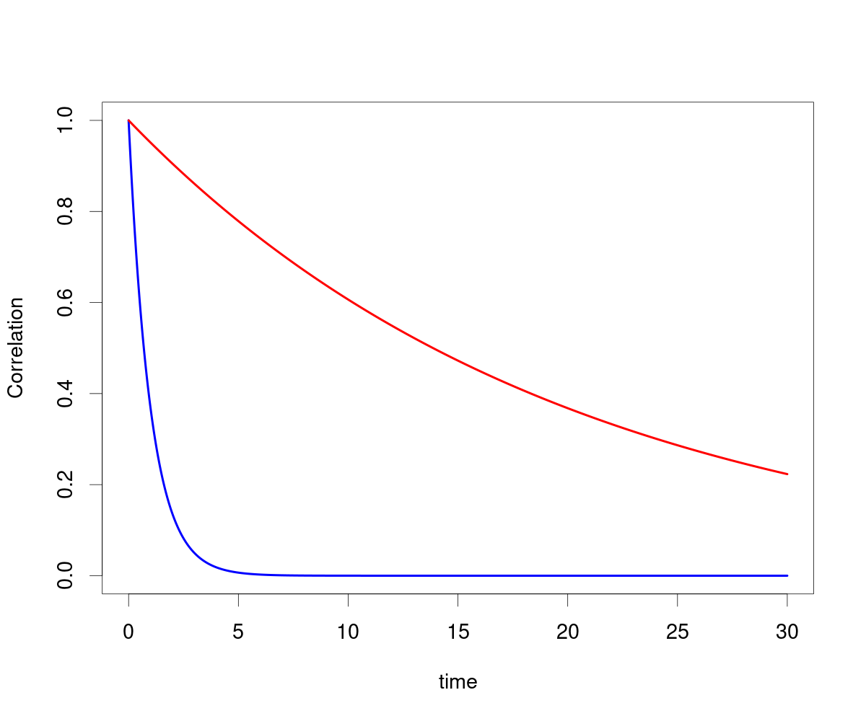
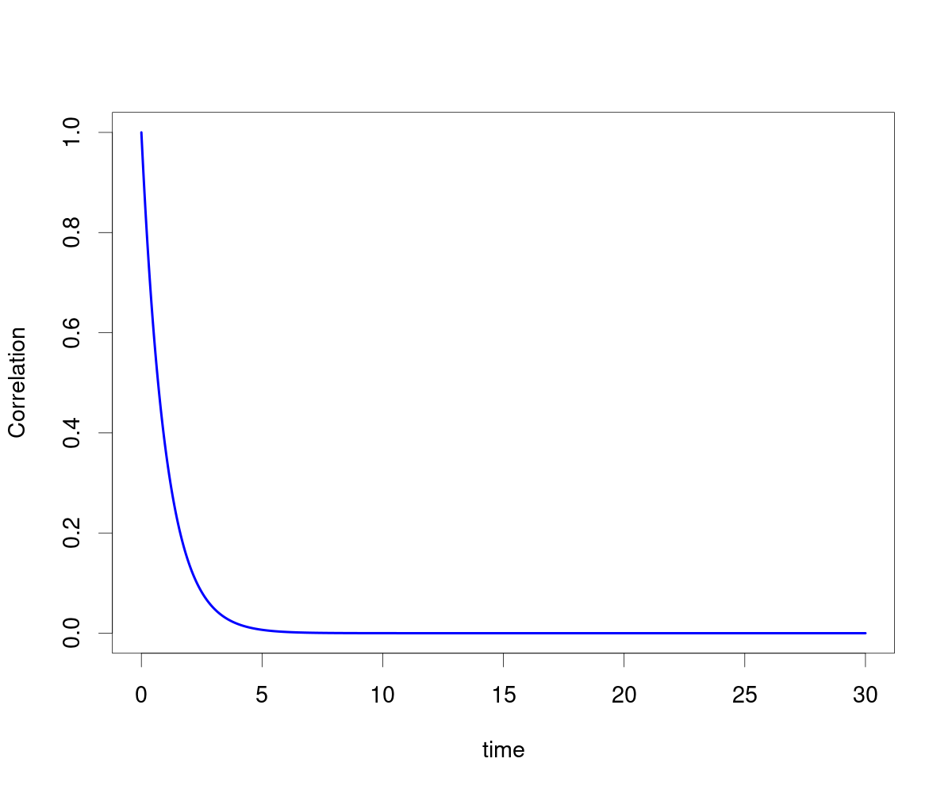
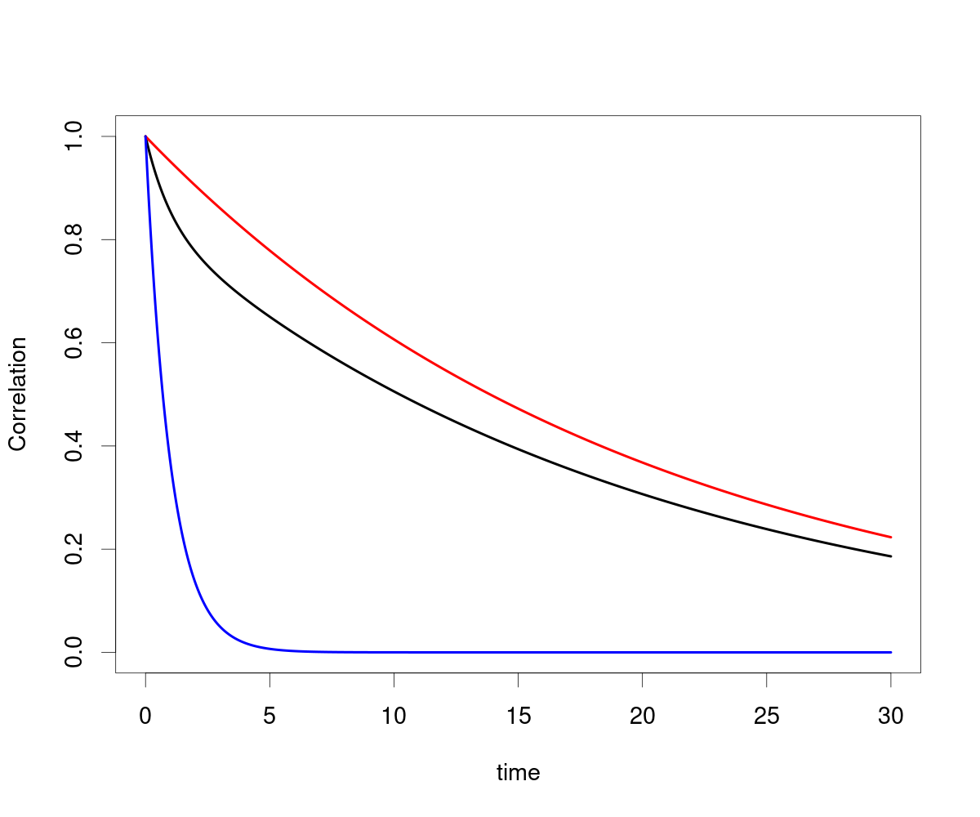
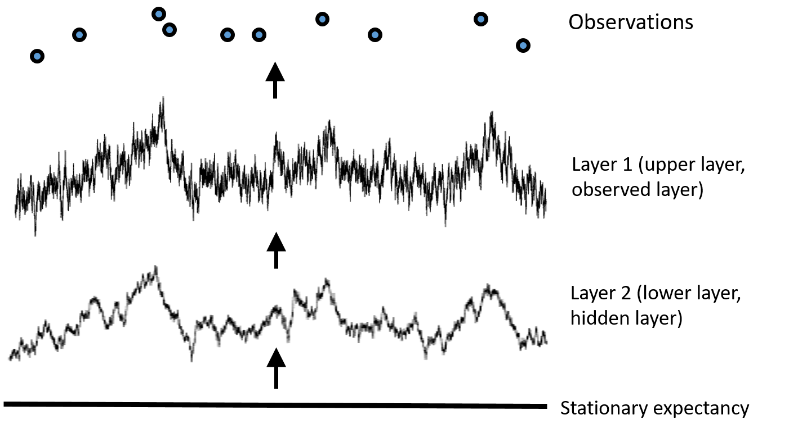
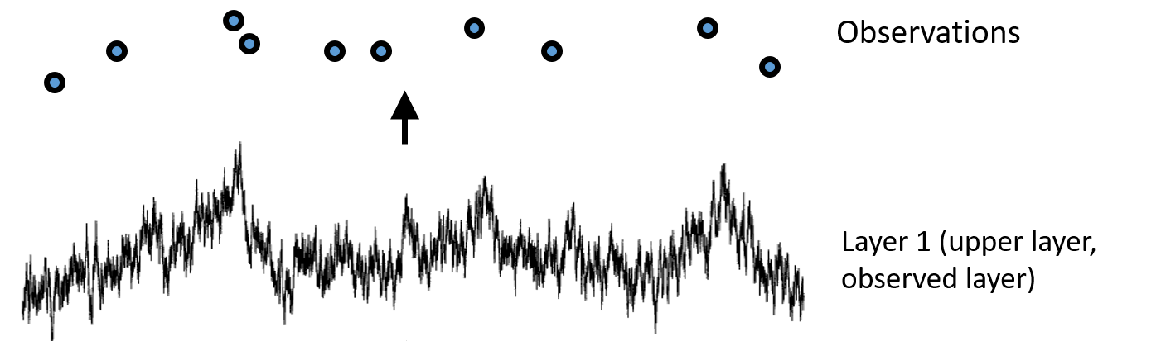
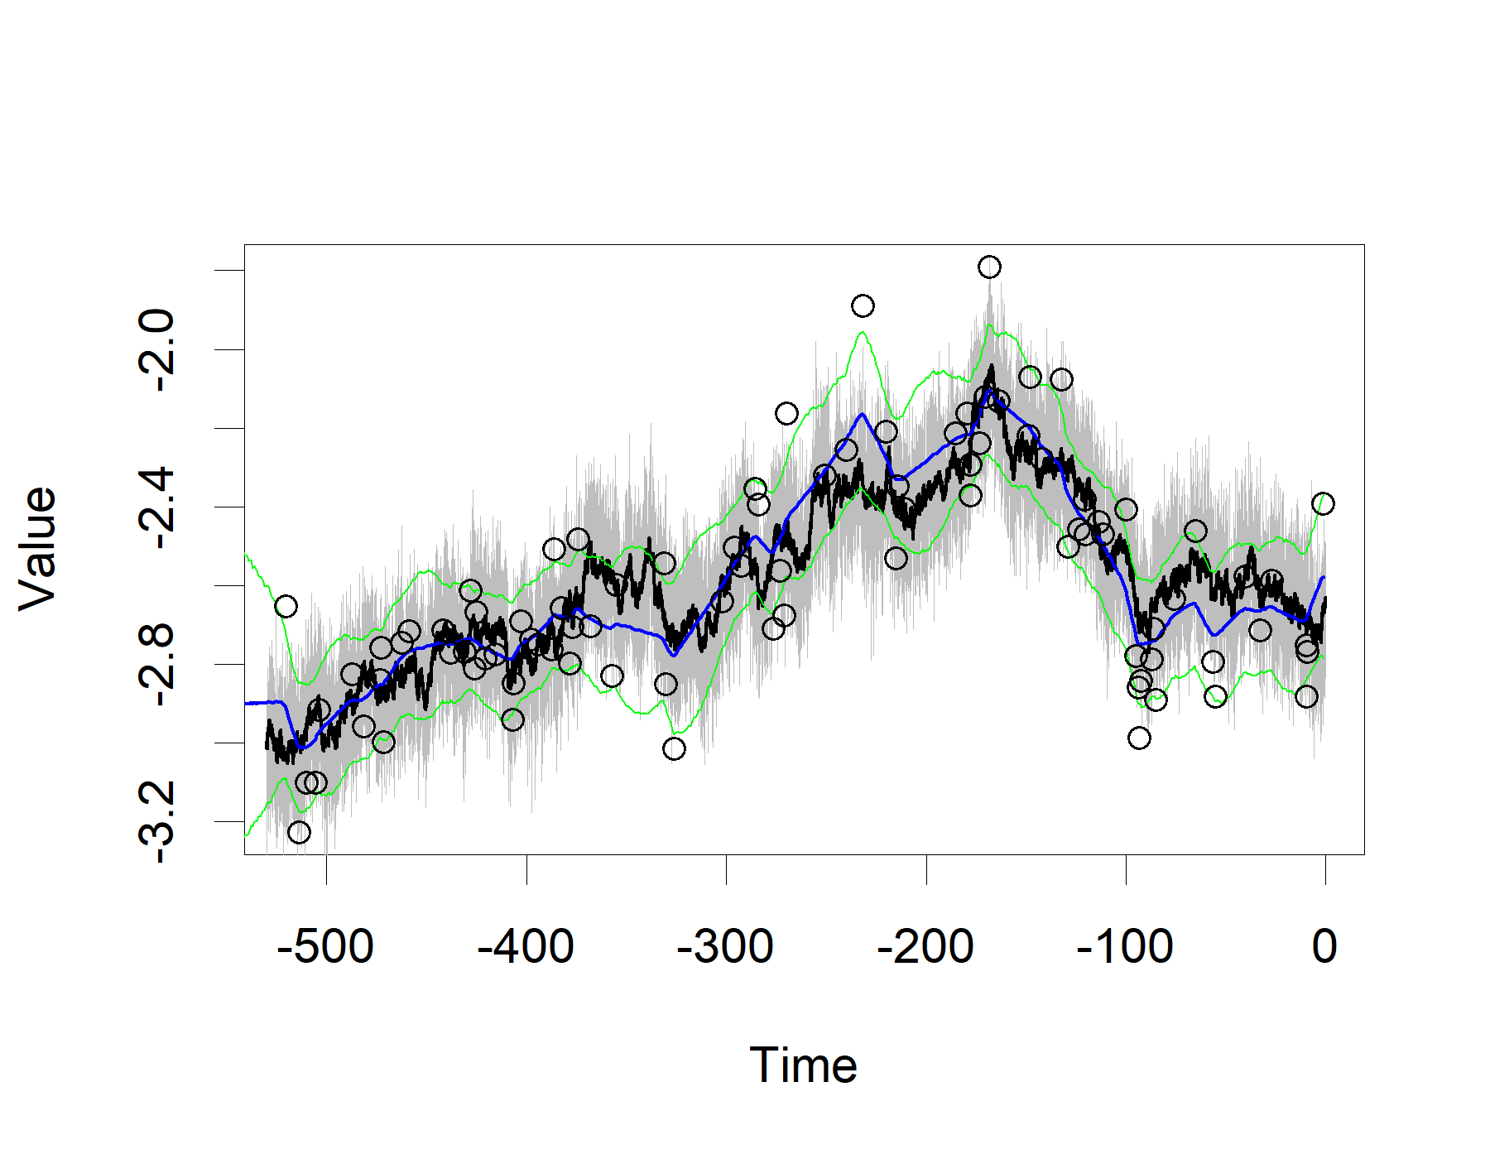
Layers
Two causally linked processes, you might only have measurements for one. Ex: phenotype and optimum.
The hidden layer can be found by its imprint on the observed layer.
Blue=top layer by itself
Red=lower layer
Black=top layer of 2-layered system
Hidden layers can be reconstructed.
(Default, but optional)
Notes:
So far, I haven’t described what a «layer» is in layeranalyzer. The idea here is that you might have two or more processes. However, only one of these two processes are measured! That sounds like the unmeasured process should be irrelevant. But when the unmeasured one causally affect the measured one, that is not the case! By the way, you can have feedback loops here. Normally you would not include these, but if you looked at the lynx data without the hare data, such a feedback loop between observed and hidden layer would be important.
An example of this came from the initial motivation for layeranalyzer, phenotypic time series. Under some struct conditions, the phenotype (some characteristic of an organism) should evolve like and Ornstein-Uhlenbeck process under natural selection and genetic drift. However, one of these assumptions is that the optimal state of the phenotype doesn’t change. What if it does change though? Well, then you have a layered system!
The reason why we can detect this is that the unmeasured process leaves its imprint on the observed process. If we look at the auto-correlation, you’d get one curve for a the single top layer, one for the bottom layer, while what you’ll observe is a mixture of these two. The auto-correlation first drops rapidly, like the top layer in this case does. But then it goes more slowly downwards after, like the underlying layer does.
Layeranalyzer represents both processes when doing the internal math for this type of analysis. I’m not going into the math here, likelihood calculations using Kalman filtering and smoothing, but instead I’ll demonstrate that it is possible to reconstruct the hidden layer. This reconstruction of course comes with uncertainty. Also the scale is uidentifiable. But as you can see in this simulation example, where we know what the hidden process actually does, you can see that actual process and reconstruction at least coarsely follow each other.

Slide 15
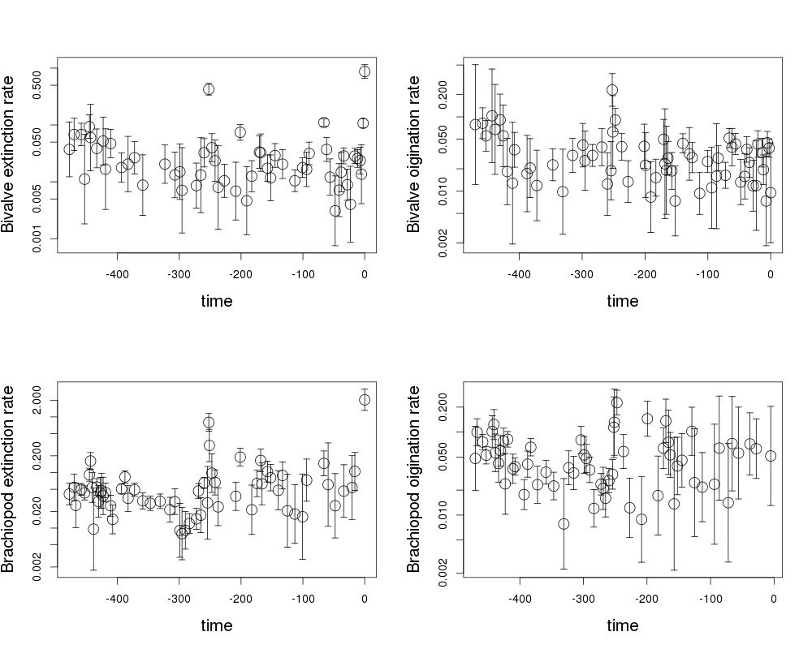
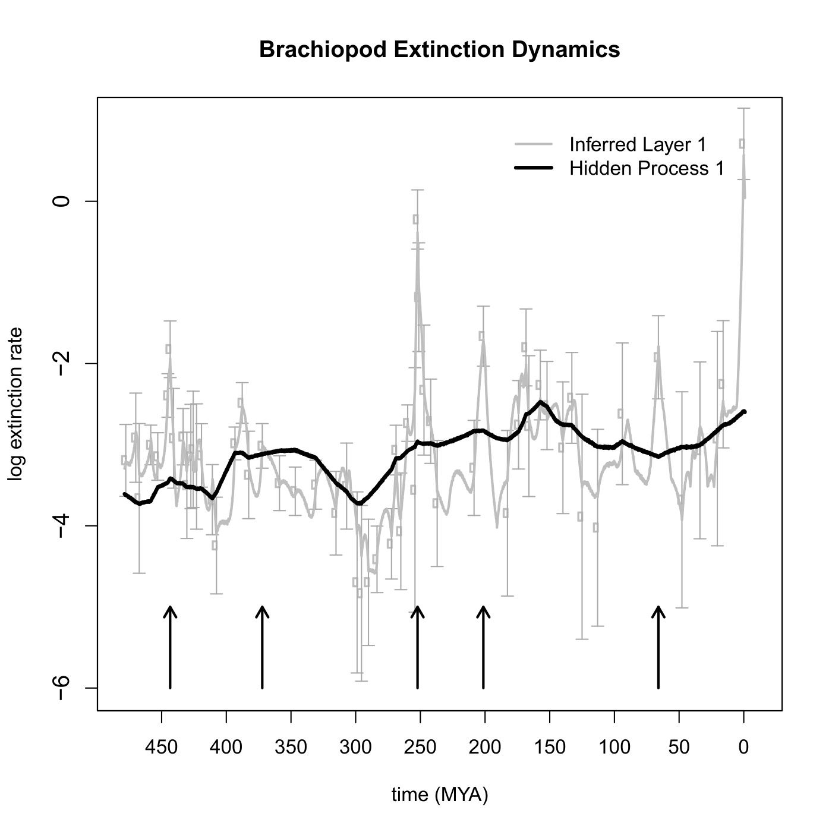
Diversification rates, bivalve/brachiopod
Data: Estimated diversification rates
Bivalve
extinction
Bivalve
origination
t_{1/2}=1.1
t_{1/2}=0.13
Hidden
process 1
t_{1/2}=3.7
Brachiopod
extinction
Brachiopod
origination
+
t_{1/2}=0.02
t_{1/2}=2.9
Hidden
process 2
Causal
t_{1/2}=37
Correlative (not found)
Notes:
Doing connection analysis becomes more difficult when there’s more than two processes in play. The number of different link models you can make grows exponentially. In this case we have 4 time series, the extinction and origination rates for bivalves and brachiopods. In addition, a hidden layer was found for the extinction rates of both bivalves and brachiopods. So there’s 6 processes in play.
Still, with some high computing resources, it was possible to get an answer. We found that in addition to a hidden process, brachiopod extinction rates was affected by bivalve extinction rates. Bivalve extinction rates also affect brachiopod origination rates which in turn affected bivalve extinction rates. The characteristic times shown here are in Millions of years.
Now, originally, we did do this analysis pair by pair, and ended up with these 3 links plus a couple of more links. That’s because when you do pairwise link analysis instead of taking all processes into account at once, you find links that are otherwise explained by other links. So for instance, we found a link between bivalve extinction and origination, but that is explained by the link from bivalve extinction to brachiopod origination and the link from brachiopod origination to bivalve origination.
Also, we were curious about the hidden process for brachiopod extinction rates, since brachiopod extinction rates are in essence this hidden process plus bivalve extinction. What we got was a process reconstruction that gradually wiggled its way upwards, but with some major dips going on in the Carboniferous era and then again in the Cretaceous. We don’t know what this process is. It could be biological or geophysical. If you have a clue, please let me know! PS: Since one can’t identify the scale of hidden processes, the actual driving process could be a flipped, going gradually down but with rises in the Carboniferous and Cretaceous.

Slide 16
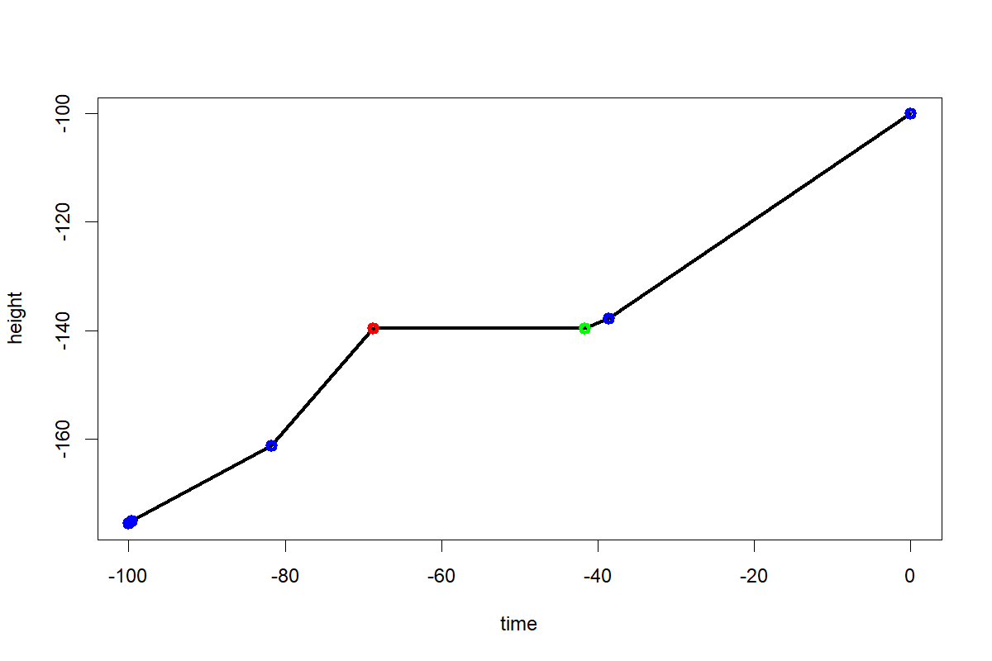
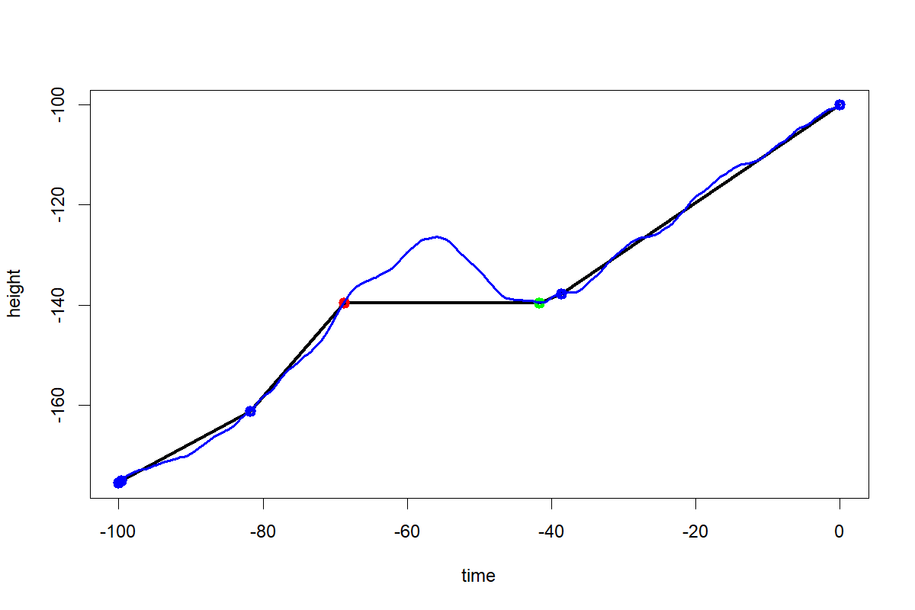
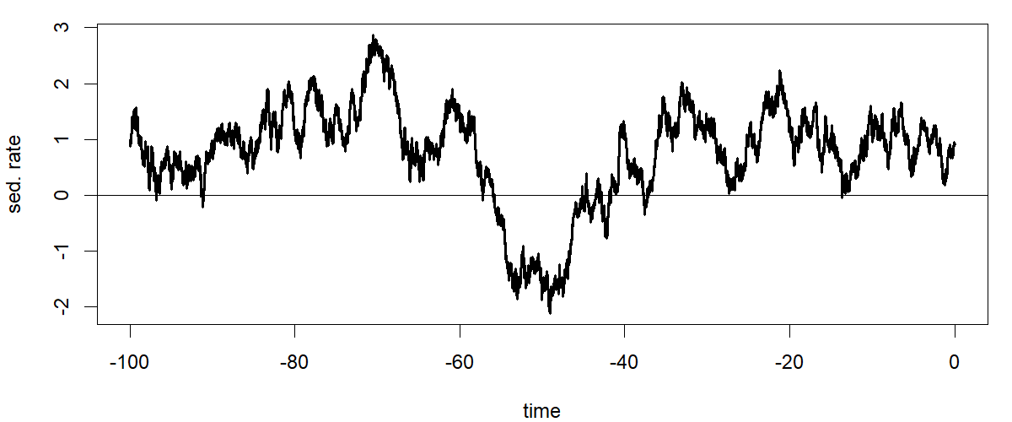
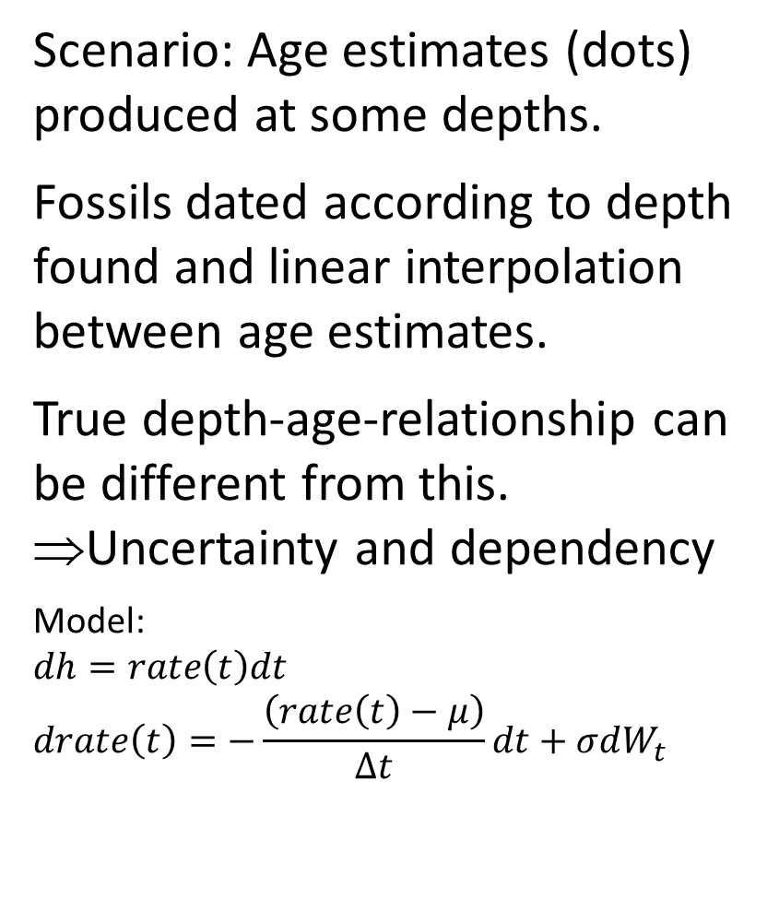
Sedimentation and integrative layers
Scenario: Age estimates (dots) produced at some depths.
Fossils dated according to depth found and linear interpolation between age estimates.
True depth-age-relationship can be different from this.
⇒Uncertainty and dependency
Model:
$$dh=rate\left(t\right)dt$$
$$drate\left(t\right)=−\frac{\left(rate\left(t\right)−μ\right)}{∆t}dt+σdW_{t}$$
Notes:
Here’s a very specialized topic, though perhaps something this audience can find interest in. When studying coccolith samples, we grappled with the problem that there was dating uncertainty in our time series of coccolith size. Could this dating uncertainty affect our inference? That uncertainty stemmed not just from age estimates being uncertain but that the fossils were sampled from other depths than from which the age estimates were sampled.
So to start with, we had the age estimates from different depths. Or since I need to organize my thoughts right, I’m using time (inverse age) and height (inverse depth). The dots here represents the height and estimated time for these heights. There can be so-called periods of stasis, where it looks like no sedimentation happened, and the start and end of such periods (shown in red and green respectively) were given special age estimation treatment. The thinking last time I was into this problem was however that these periods weren’t true stasis but rather that sedimentation had happened but with subsequent digging (inverse sedimentation if you will).
Fossils, which were found at different heights, were given a time (or age) estimate using linear interpolation between the age estimate points. But of course, that’s not the true dating of these fossils, because of two factors. First, age estimates ado come with some uncertainty.
But secondly and more importantly, what happened between these estimates would not be exactly linear. The true time-height process would deviate from these lines.
So that means two things. 1) that the fossils dating comes with some uncertainty and 2) the dating errors are going to be correlated when inside the same gap between age estimates.
In order sample possible time-height trajectories and thus dating models for the fossils, we made a model. We let height be the integral of sedimentation rate. And we let sedimentation rate be an OU process. Since a OU process can dip below zero, that allows for periods of digging, so periods of «stasis» can also be modelled. And when we sample realizations of this process, we can produce dating models for the fossils, which we then fed into the inference. Luckily in our case, our time series analysis was robust to the dating uncertainties.

Slide 17
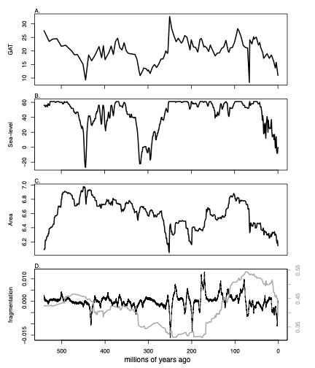
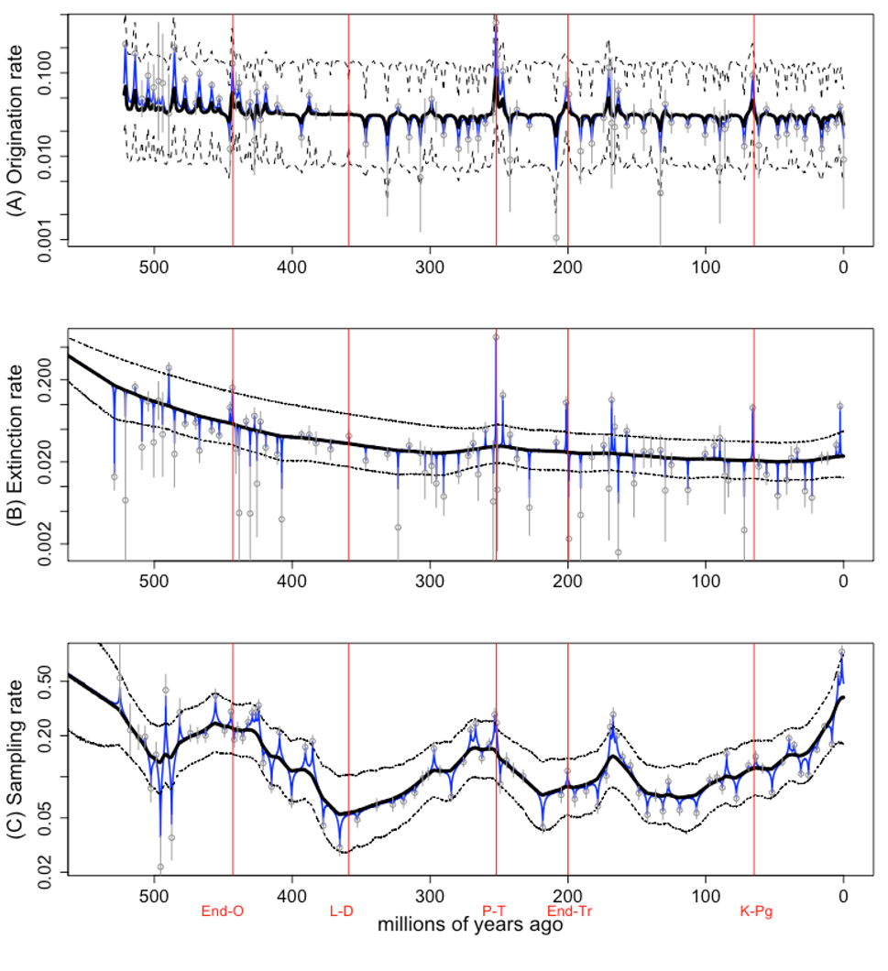
Latest results
Marine diversity vs some possible climatic drivers.
Structural analysis of each diversification series. Hidden layers found!
Link analysis between climatic and divers. series. Correlative link between marine sedimentation area and marine origination and extinction.
Notes:
This last example is the latest analysis using layeranalyzer, performed by Connor J. Wilson, Lee Hsiang Liow and me. Originally, we wanted to study marine diversity, i.e. extinction and origination rates plus sampling rate, versus fragmentation rates. By the way, fragmentation rate was inferred from a reconstructed fragmentation index using the integration layer approach from previous slide.
However, the reviewers wanted us to go on a fishing trip, looking at various reconstructed abiotic drivers. We ended up with looking at fragmentation rate, marine sedimentation area, sealevel and global average temperature. I’m more than a little wary about reconstructed time series, but reviewers and editors wishes are law.
So, we did a structural analysis, finding hidden layers in the diversification series.
We then performed pairwise link analysis between the various processes, though we only looked at correlative links plus causal links for abiotic to biotic time series. No sense looking at feedbacks here. Since there was a lot of statistical tests here, we did Bonferroni correction to taking multiple testing into account. We don’t want to be accused of p-hacking.
Anyway, even with taking multiple testing into account, we did find some links, though not for fragmentation rate, like what we originally looked for. Rather marine sedimentation rate was the thing that stood out. Unfortunately we only found correlative links, not causal ones. That suggests there might be a fast-moving common cause, or that marine sedimentation rate is correlated to a driver of marine diversification.

Slide 18



Closing words
Project web page: https://github.com/trondreitan/layeranalyzer
Paper: “layeranalyzer: inferring correlative and causal connections from time series data in R”, Methods in Ecology and Evolution. DOI: 10.1111/2041-210X.13299
Funded by the RCN and ERC.
Original ideas, Tore Schweder.
Notes:
So, now it only remains for me to present the web page and present the grant stuff. I should also tell that Tore Schweder, from the dept. of Economy, was the one who came up with the original ideas. He unfortunately passed away recently.
Anyway, I thank you for the attention and lets see if there are any questions or if everything was clear as glass!

Slide 19
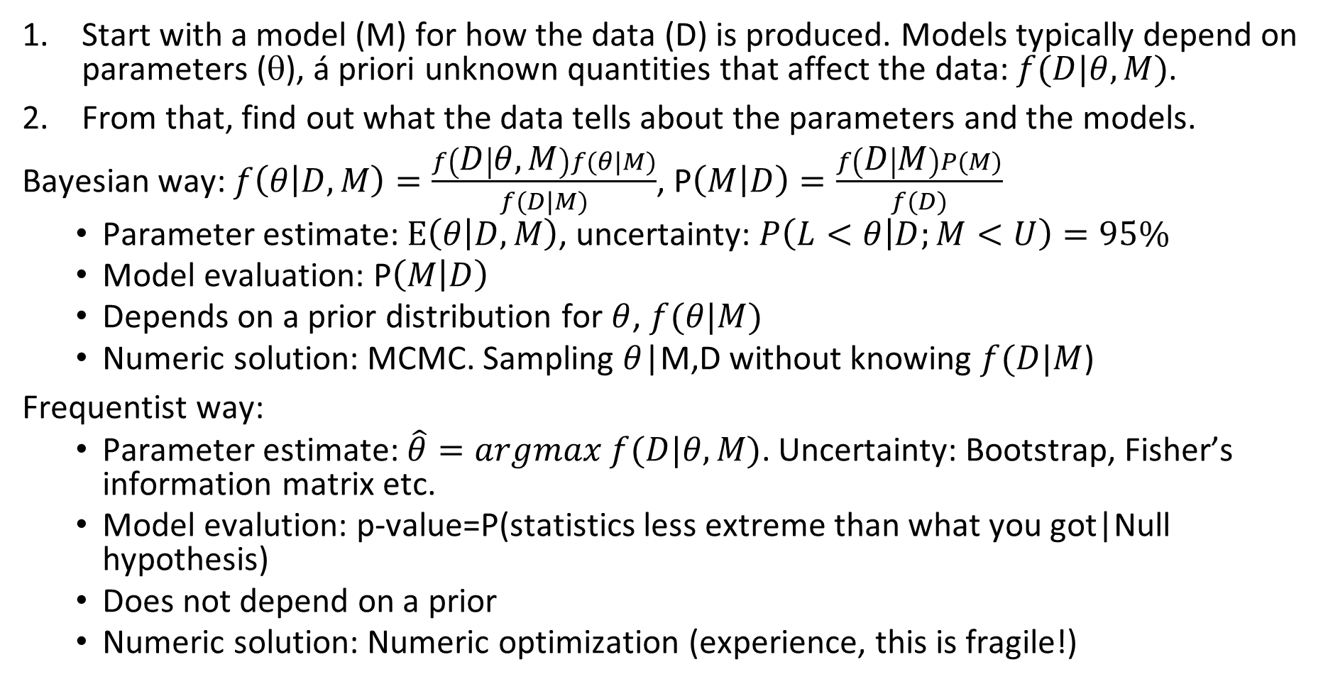
Crash course in statistics!
Start with a model (M) for how the data (D) is produced. Models typically depend on parameters (θ), á priori unknown quantities that affect the data: $f(D|θ,M)$.
From that, find out what the data tells about the parameters and the models.
Bayesian way: $f\left(θ | D,M\right)=\frac{f\left(D | θ,M\right)f(θ|M)}{f(D|M)}$, P$\left(M | D\right)=\frac{f\left(D | M\right)P(M)}{f(D)}$
Parameter estimate: $E\left(θ | D,M\right)$, uncertainty: $P\left(L<θ | D;M<U\right)=95\%$
Model evaluation: P$\left(M | D\right)$
Depends on a prior distribution for $θ$, $f(θ|M)$
Numeric solution: MCMC. Sampling $θ$|M,D without knowing $f(D|M$)
Frequentist way:
Parameter estimate: $\hat{θ}=argmax f(D|θ,M)\text{.}$ Uncertainty: Bootstrap, Fisher’s information matrix etc.
Model evalution: p-value=P(statistics less extreme than what you got|Null hypothesis)
Does not depend on a prior
Numeric solution: Numeric optimization (experience, this is fragile!)

Slide 20
R code example
# install.packages("https://github.com/trondreitan/layeranalyzer/raw/master/layeranalyzer_0.2.1.tar.gz", type="source",verbose=T, build_vignettes=TRUE)
library(layeranalyzer)
# Read data:
malta=read.table("http://folk.uio.no/trondr/layered/malta.csv",sep=";",header=T)
# Define data series in layeranalyzer form:
X=layer.data.series(time.points=malta$Time.Year, value.points=malta$Mean..log.body.mass.,
std.dev=sqrt(malta$Variance.calculated.from.the.data),
num.meas.per.value=malta$Sample.size,name="log.body.size")
# Perform model analyses on a process models below a complexity level:
models.ml=traverse.standalone.layered(X, max.layers=2, do.maximum.likelihood = TRUE, maximum.likelihood.numstart = 1000)
# Compare using AICc:
compare.layered(models.ml, ML.IC = "AICc")
# Best is linear trend OU, make a summary:
summary(models.ml[[3]])

Slide 21
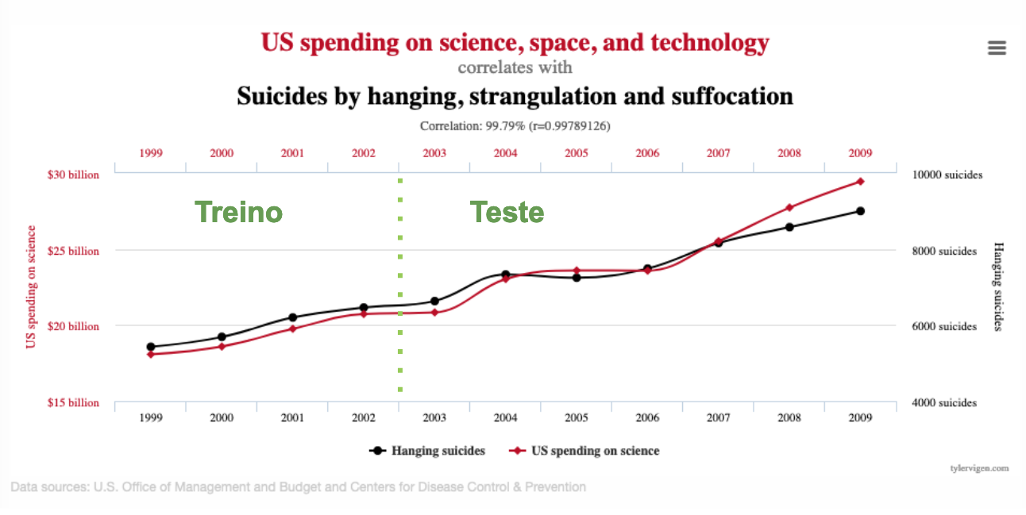

Slide 22
https://www.michaeldiamond.com/beware-spurious-correlations/

Slide 23
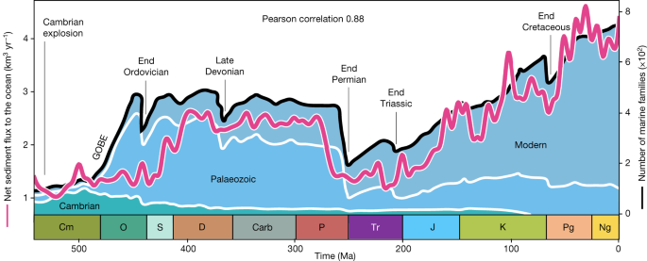
Salles et al. 2023 Landscape dynamics and the Phanerozoic diversification of the biosphere Nature 624: 115–121
“The reconstructed net sediment flux to the ocean and the total number of marine families are strongly correlated (Pearson coefficient 0.88) and sediment flux variation markedly matches the three main phases that span the Phanerozoic eon (Fig. 3 and Extended Data Fig. 10a). This suggests that nutrient availability is a prime control on marine diversity.”
Notes:
#differencing (Differencing to remove a trend or seasonal effects)
#https://atsa-es.github.io/atsa-labs/sec-tslab-differencing-to-remove-a-trend-or-seasonal-effects.html
# you will likely hear a lot of about "first differencing" in paleo papers.
# first differencing can remove linear trends and might be a bit helpful in reducing the chance
#that two time series that are trending in time for no real reason will not be mistakenly
#thought to be correlated.

